Slide 1
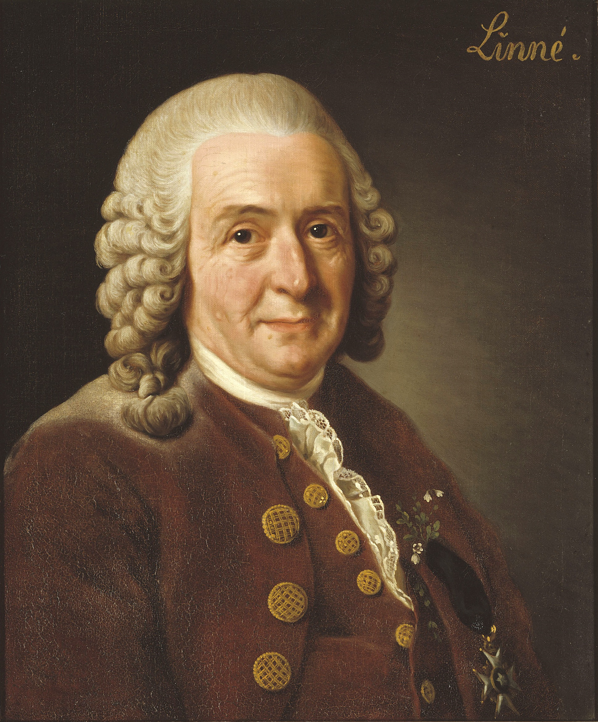
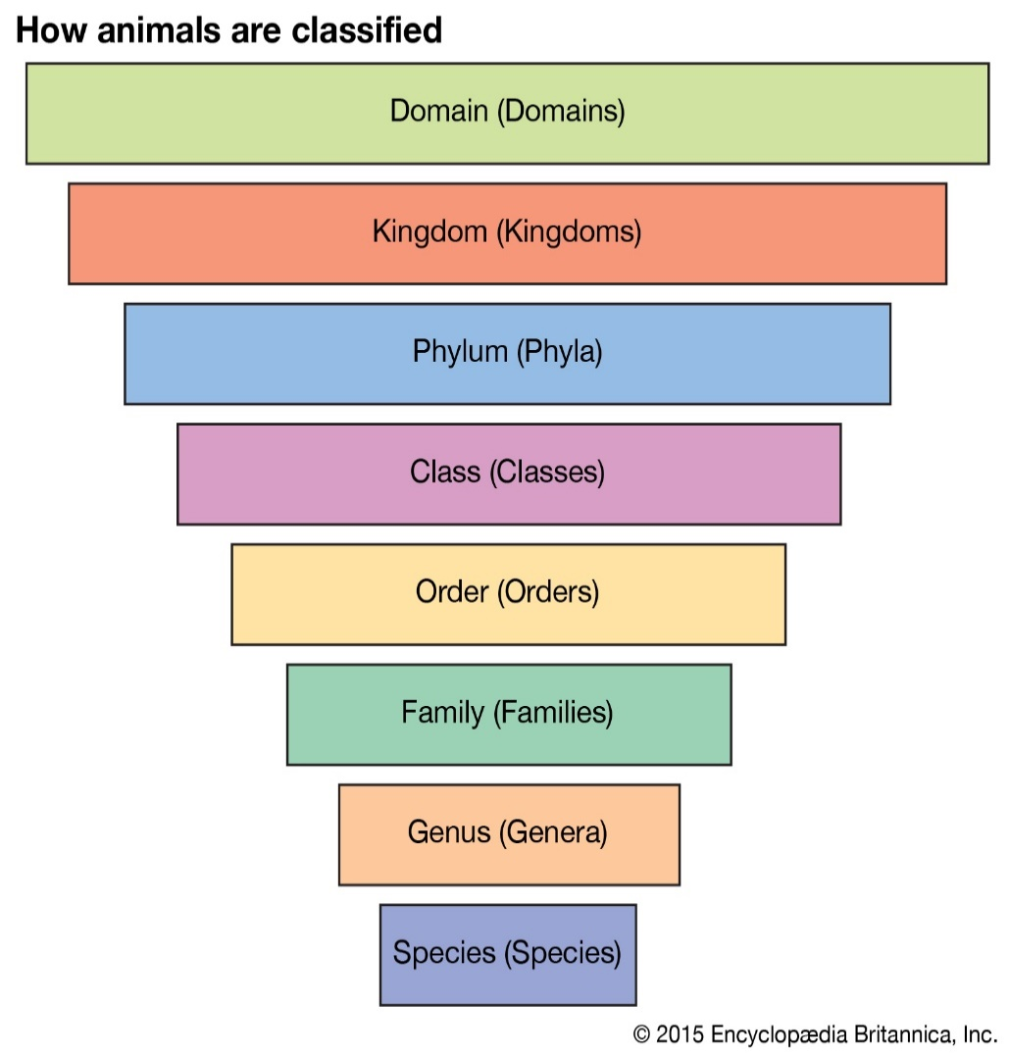
Science: Year 6
Living Things and Their Habitats
Knowledge Organiser
Vertebrate Classes Within The Animal Kingdom
Fish | cold-blooded scales covering its body has fins lives in water, lays eggs in water breathes through gills
Amphibian | cold-blooded start as eggs in water and breathe through gills later develop lungs and live on and and in water lays eggs in water damp skin/body
Reptile | cold-blooded breathes with lungs dry, scaly skin lay soft-shelled eggs on land
Bird | warm-blooded breathes with lungs lays eggs with hard shells covered with feathers have wings but not all can fly
Mammal | warm-blooded have fur or hairy skin give birth to live young feed their young milk
Significant Scientist
Carl Linnaeus was a Swedish scientist who developed the modern system of classifying and naming organisms. Before this the names of living things were often very long. He gave them a two-part name.
These are the vertebrate classes
Key Vocabulary
Vertebrate | Animals that have a backbone. They can be divided into 5 groups: fish, amphibians, reptiles, birds and mammals.
Invertebrate | Animals that do not have a backbone. Can be divided into several groups including insects, arachnids, molluscs and annelids.
Micro-organisms | These are tiny living creatures. Most can only be seen through a microscope. They can be sub-divided into smaller groups including bacteria, fungi, viruses, animals and plants
Classification | Organisms can be classified into broad groups according to observable characteristics that are similar or different.
Non-flowering plants:
smaller group. They have a simple structure and do not have flowers or seeds. They reproduce through spores. E.g. algae, mosses
Flowering plants: numerous and diverse group. Reproduce through flowers and seeds. E.g. sunflower

