Slide 1
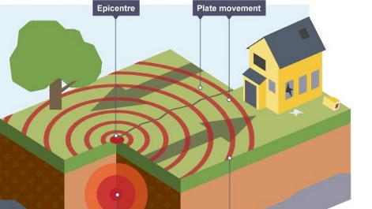
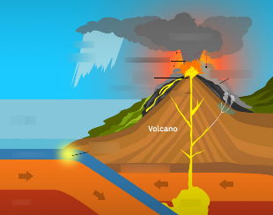
Year 3 Geography Knowledge Organiser
– Earthquakes and Volcanoes.
Learning Objectives
To identify the Ring of Fire on a map and some continents and countries within it
To describe and understand how earthquakes occur
To describe and understand how volcanoes occur
To explain the significance of tectonic plates
Key Facts and Information
An Earthquake is the shaking and vibration of the Earth’s crust due to movement of the Earth’s plates (tectonic plates). Earthquakes can happen along any type of plate boundary.
Volcanoes are formed by: Magma rises through cracks or weaknesses in the Earth’s crust. Pressure builds up inside the Earth When this pressure is released, e.g. as a result of plate movement, magma explodes to the surface The lava from the eruptions cools to form new crust Over time, after several eruptions, the rock builds up and a volcano forms.
There are three types of plate boundaries: convergent, divergent and transform
90% of all earthquakes occur along the Ring of Fire and 75% of all active volcanoes are located around the ring
Vocabulary
Volcano | An opening or rupture in the Earth’s crust through which lava, ash and gases can escape.
Magma | A molten substance beneath the Earth’s crust.
Earthquake | A violent movement of parts of the Earth’s surface.
Mountain | An elevated part of the Earth, typically with steep sides.
Fault line | A long crack in the Earth’s surface.
Tectonic plate | Huge pieces of the Earth’s surface.
Lava | Molten rock flowing from a volcano.
Crate | The mouth of a volcano.
eruption | When a volcano shoots out lava.
epicentre | The point on the Earth’s surface at the centre of an Earthquake.
mantle | Under the crust is the mantle forming about half of the Earth.
Earth’s crust | The surface layer covering our planet.
core | The core is at the centre of the Earth. There is a solid inner core and outer liquid core of molten metal.
Key Questions
What is a volcano? How are they formed? What are earthquakes? How are they formed? What is the Ring of Fire? What is the Earth’s crust? What are the plate boundaries? How are earthquakes measured?

