Slide 1
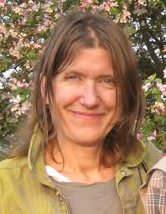
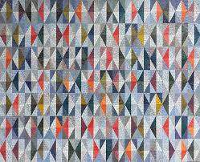
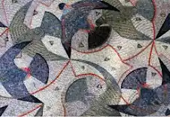
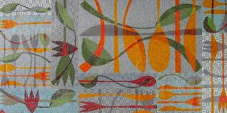
Year 3 – Summer 2
Art: Mosaic
Knowledge Organiser
Key Learning Objectives
To know key facts about Emma Briggs and mosaics.
To use a range of materials to create mosaic effect.
To develop technique with printing to create a mosaic effect.
To explore Greek vase mosaic art.
To explore creative work in the style of Emma Biggs and mosaics.
Key Facts and Information
Mosaics were a popular way to decorate churches in Italy in the Medieval period
Mosaics often last for a very long time
Many beautiful mosaics date from the early Christian and Byzantine eras, from about 300 AD to 1400
Emma Biggs is a professional mosaic artist.
Emma's work is most closely associated with an interest in colour and pattern
Vocabulary
Mosaic | A picture or design made by putting together lots of small, colourful pieces of glass, stone, or other materials
Print | A work of art created by transferring an image from one material to another surface, usually paper
Pattern | A design created by the repeated use of lines, shapes, forms, or colours
Contemporary | Art made today by living artists
Mortar | Cement used for setting mosaics
Tesserae | The individual pieces of tile used in mosaic making
Tessellating | Creating a pattern using shapes that fit together perfectly
Key Questions –
What is a mosaic? How are they made? What materials are used to make them?

