Slide 1
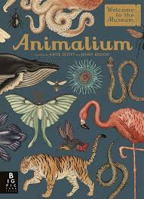
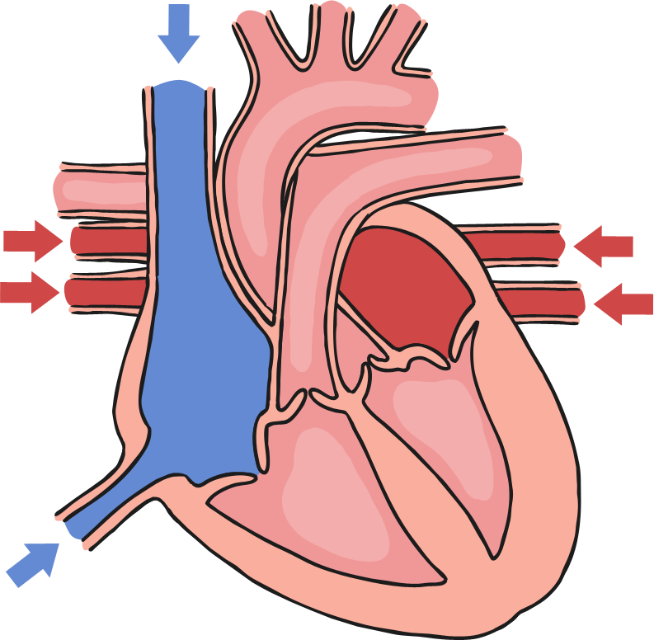
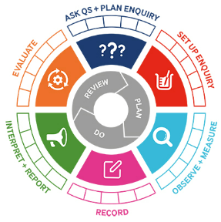
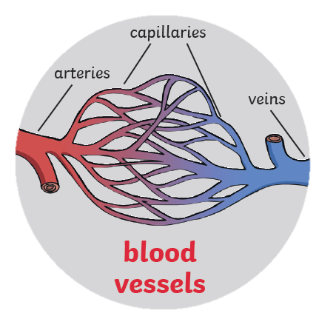
Science: Year 6
Animals including humans
Knowledge Organiser
Learning Objectives
LO: identify and name the main parts of the human circulatory system, and describe the functions of the heart, blood vessels and blood
LO: recognise the impact of diet, exercise, drugs and lifestyle on the way their bodies function
LO: describe the ways in which nutrients and water are transported within animals, including humans
What should I already know?
I know the importance for humans of exercise, eating the right amount of different food hygiene I know that animals including humans need the right types and amount of nutrition. They cannot make their own food, they get nutrition from what they eat I know the simple functions of the basic parts of the digestive system in humans I know the different types of teeth in humans and their simple functions
Key Vocabulary
Heart | The heart pumps blood around your body
Pulse | Each time the heart beats it can be felt as a pulse in the arteries. Typically, in the wrist and neck.
Blood | The red liquid pumped around the body by the heart. It transports Oxygen, nutrients and water to all the parts of the body.
Blood Vessels | The narrow tubes which our blood flows through including the arteries, veins and capillaries.
Lungs | Two organs situated in the ribcage that fill with air when you breathe in. They remove carbon dioxide from blood and add Oxygen.
Circulatory System | This circulates blood through the body. It consists of the heart, blood and blood vessels
Diet | The sort of food animals or humans regularly eat.
Exercise | Activity that requires physical effort, carried out to sustain or improve health and fitness.
Drugs | A medicine or other substance that has a chemical effect in a person’s body.
Lifestyle | The way in which a person lives.
TAPS assessment
Heart rate poses
Class reader

