Slide 1
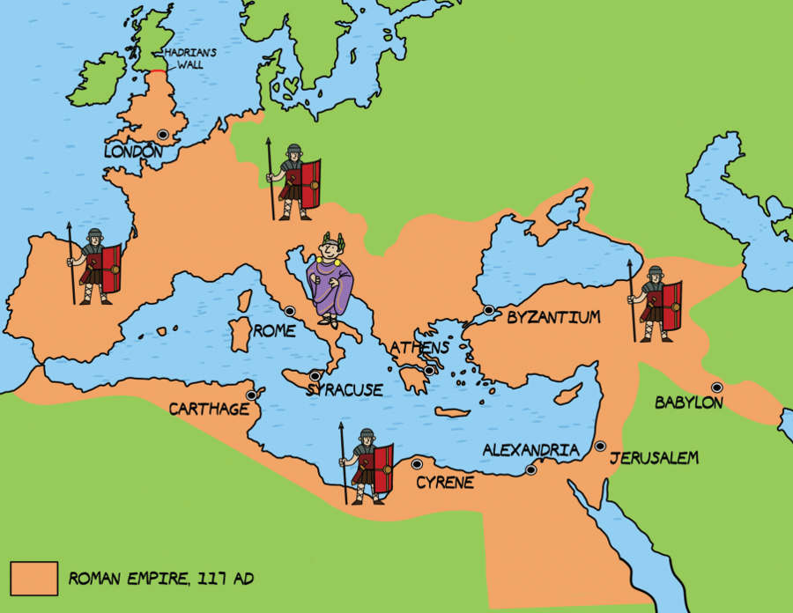
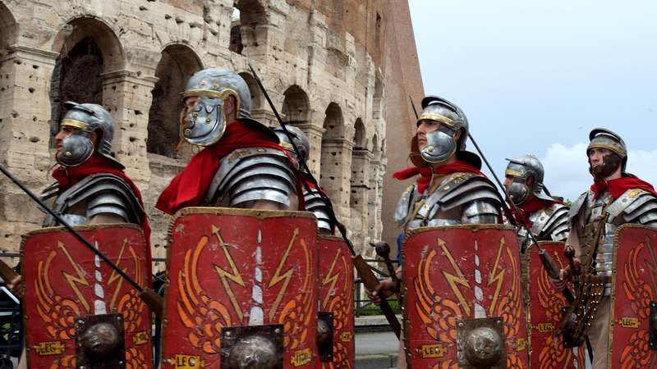
Year 6
History - Romans
Knowledge Organiser
Learning Objectives
LO: To know when the Roman Empire happened
LO: To understand the impact that the Romans had on Britain
LO: To explore the impact that Julius Caesar’s attempted invasion had on Britain in 55-54BC
LO: To explore the impact Boudica had on the Roman Empire and Britain
Key Facts and Information
The Celts lived in Britain before the Romans; however, no-one called them Celts until the eighteenth century. In fact, the Romans called these people Britons.
The Roman General Julius Caesar came across the sea to Britain. He wanted to make Britain a part of the Roman Empire.
Roman legions: there were around 5000 soldiers in a Roman Army legion.
Boudicca was a Celtic Queen
Vocabulary
Empire | A group of countries ruled by a single person, government or country.
Emperor | The ruler of an empire.
Celt/Iron Age Briton | A person who lived in ancient Britain in the time before the Romans.
Invade/ Invasion | To enter a place in a forceful way.
Legion | A large group of soldiers who form a part of an army.
Barbarian | A person that lived outside the Roman Empire, seen by the Romans as violent and uncivilised.
Centurion | An officer commanding about 0 legionaries.
Key Questions
When did the Roman Empire begin? What is the importance of the Roman Empire on Britain? How did Julius Caesar’s failed attempt impact Britain? Who was Boudicca? What impact did Boudicca’s resistance have on Britain?

