Slide 1
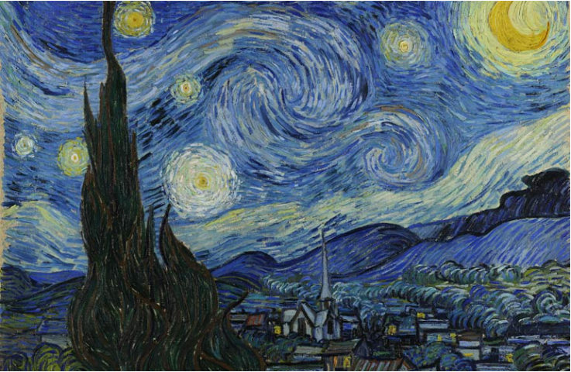
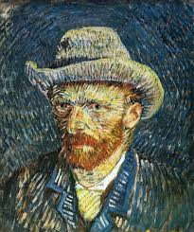
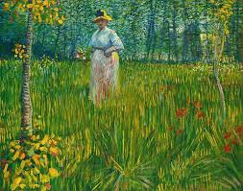
Year 6 – Autumn 2
Art: Brushstrokes and choice of colour
Knowledge Organiser
Key Learning Objectives
To know key facts about Van Gogh and Impressionism
To explore painting techniques including brushstrokes to create movement
To develop drawing techniques to consider composition and texture
To explore use of colour to create effect
To explore creative work in the style of Van Gogh/impressionism
Key Facts and Information
Van Gogh only started painting at the age of 27 years old and by the time that he died, at age 37, he had only sold one painting.
Van Gogh was nicknamed “le fou roux” (The Redheaded Madman)
After cutting off part of his ear, he checked himself into an asylum. Whilst there, he completed his famous work ‘Starry Night’
Impressionists painted outdoors. As they were outside, they looked at how light and colour changed the scenes.
They often painted thickly and used quick (and quite messy) brush strokes.
In most of the paintings before impressionism, you can't really see the brushstrokes at all.
Impressionists rebelled against classical subject matter and embraced modernity
Vocabulary
Impressionism | A style of art originating in France where the artist paints an ‘impression’ of the person, light, atmosphere or object.
Composition | The arrangement of elements and subject matter in art.
Optical illusions | Optical Illusions can use color, light and patterns to create images that can be deceptive or misleading to our brains
Texture | How something feels when it is touched
Key Questions
How are brushstrokes created? How does the colour create the effect? What is composition? How can brushstrokes create the illusion of movement?

