Slide 1
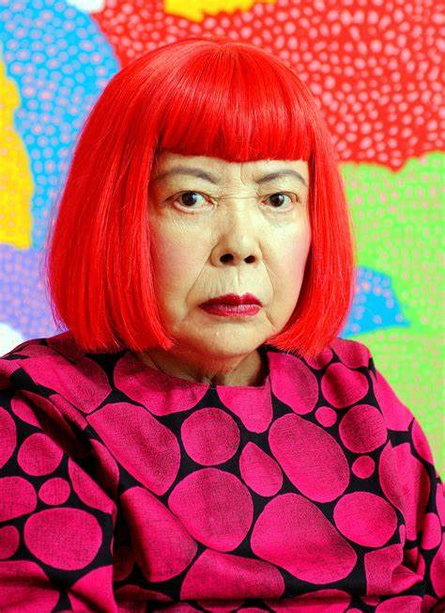
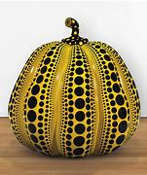
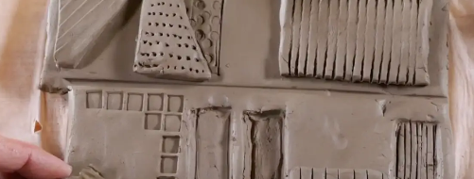
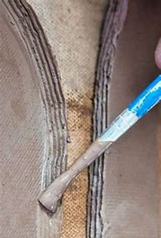
Year 2 – Autumn 1
Art: Sculpture
Knowledge Organiser
Key Learning Objectives
To know key facts about Yayoi Kasama and her style
To join clay using a slip and score technique
To create a 3D sculpture from clay using impressing and joining techniques
Key Facts and Information
Yayoi Kasama is a Japanese artist who is known as the Queen of Polka dots. She is recognisable by her bright red wig and lips and stated that all of clothes, including her pyjamas, are stained with paint!
Yayoi Kasma gave great influence to Andy Warhol with her experimental, avant-garde style.
Yayoi Kusama has a strong, political conscious and created a series of anti-war collages.
Vocabulary
Impressing | Using a tool, object or material to press into clay
Score and slip | Bringing two pieces of clay together, to make a whole
Avant-garde style | A new and experimental style of art, music or literature.
3D form | A solid, 3-dimensional shape or structure
Clay | A sticky earth that can be moulded when wet and can be dried and baked to make pottery, bricks or ceramics.
Key Questions
How can clay be joined together? How can I use tools to change the look of my clay? How can I create 3D form?

