Slide 1
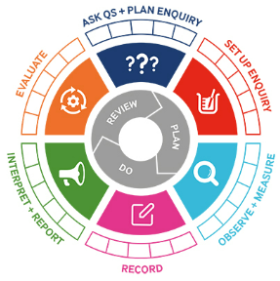
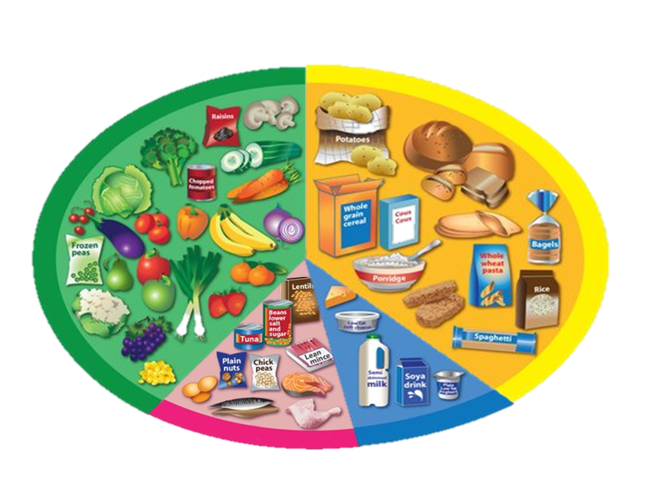
Science: Year 2
Animals including humans
Knowledge Organiser
Learning Objectives
LO: To notice that animals, including humans, have offspring which grow into adults
LO: To find out about and describe the basic needs of animals, including humans, for survival (water, food and air)
LO: To describe the importance for humans of exercise, eating the right amounts of different types of food, and hygiene
What should I already know?
I can identify, name, draw and label the basic parts of the human body and say which part of the body is associated with each sense
Key Vocabulary
Offspring | The next generation (Not always young or babies).
Reproduction | The process where new living things (e.g. animals, humans or plants) are made.
Growth | The process of getting bigger.
Exercise | This is when you move your body physically to get fit and remain healthy. Our heartbeat increases when we exercise.
Breathing | This is what we do to get Oxygen in our bodies.
Hygiene | Keeping clean to prevent illnesses and the spread of disease
Germs | A very small thing that can cause diseases. We cannot see them with our eyes.
Disease | An illness which affects people, animals or plants.
TAPS assessment
Comparing hand spans.
Class reader
Fussy Freda – Julia Jarman

